Slide 1
Final Project
Submitted to: Professor Sam Plati
Submitted by: Arjun Rehal
Student ID:100890862

Slide 2
Problem statement
Mr. John Hughes, needs help in predicting customer churn based on a dataset containing various customer characteristics and their churn position. The dataset consists of 3,333 observations with 11 variables, including features such as account tenure, contract renewal status, data plan subscription, customer service calls, and usage metrics like data usage, daytime minutes, and roaming minutes.
This presentation will provide an in-depth examination of customer churn prediction using different machine learning algorithms. Key insights from the dataset, model performance assessments, and recommendations for model implementation will be highlighted in the presentation. The presentation aims to assist Mr. Hughes in making sensible choices to improve customer retention strategies and business outcomes.

Slide 3
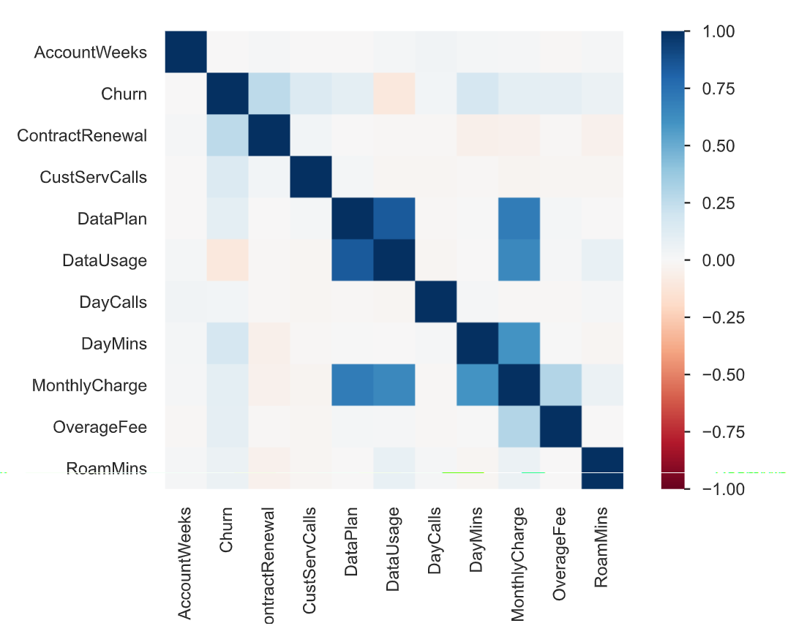
EDA Key Insights
It is clear from the heatmap that Data Plan ,Data Usage and DayMins is highly co-related with MonthlyCharge. Moreover Data Plan and Data Usage are also co-related with each other. So working on these variables can help retain the customer. For example, by lower the price of monthly charge might increase custormers.

Slide 4
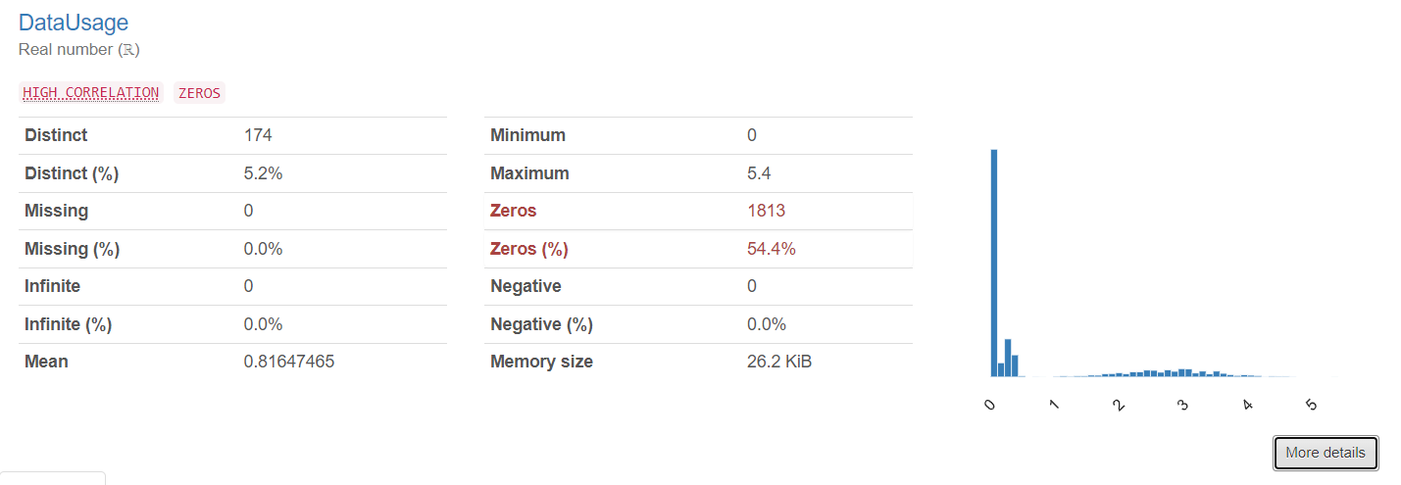
Significant Proportion of Zero Data Usage:An analysis of the DataUsage feature shows that 54.4% of observations have no data usage. This implies that a significant number of clients may not actively use data services. Knowing the causes of this inadequate use of data may help with targeted marketing or service enhancements by revealing consumer behavior and preferences.

Slide 5
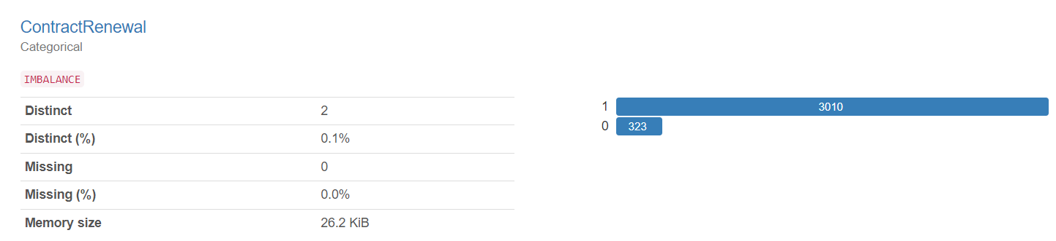
Imbalanced Distribution of Contract Renewal: The ContractRenewal feature shows an imbalance in its distribution, with a significantly higher proportion of observations (approximately 90.3%) indicating contract renewal. This imbalance could impact model training and prediction accuracy, particularly if the minority class (non-renewal) is of particular interest, such as in churn prediction.

Slide 6
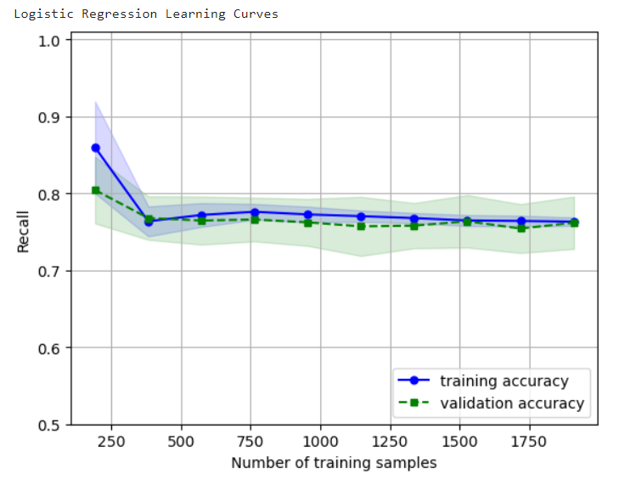
Learning Curves(Logistic Regression)
1.The training recall went down by a few point in the beginning. However, with the increases in number of training samples the model starts to work better with generalized data. This model shows low training recall and validation recall, that mean the model underfits the training data and this the case of high bias.
2. With the increase in number of training samples seems to be converging that means there is no point of adding training samples to the model.

Slide 7
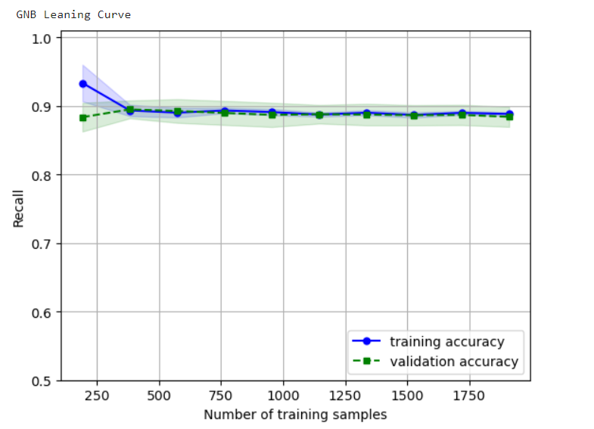
GNB
The model training accuracy went down initially with more number of training samples, but it became stable after the samples increased from 300.
Again more data will be of no use here, because the validation curve is almost parallel to the x axis. That means, the model is performing at it best with the general data set.

Slide 8
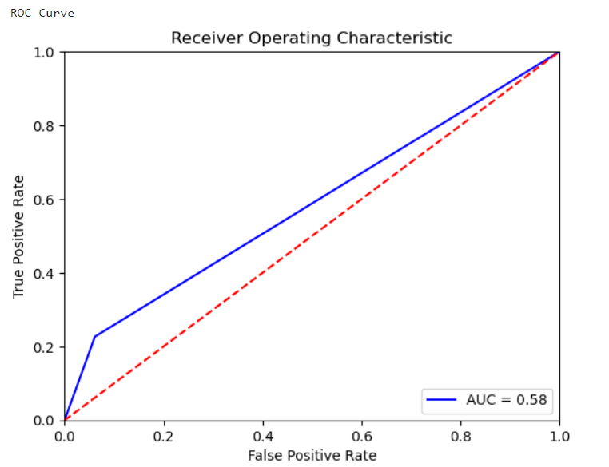
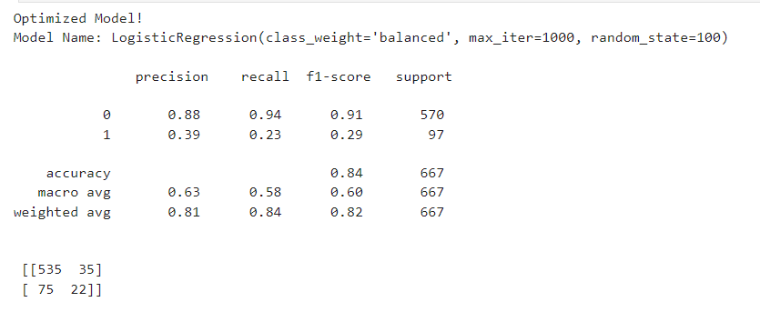
Classification Report and ROC/AUC(LogisticRegression)

Slide 9
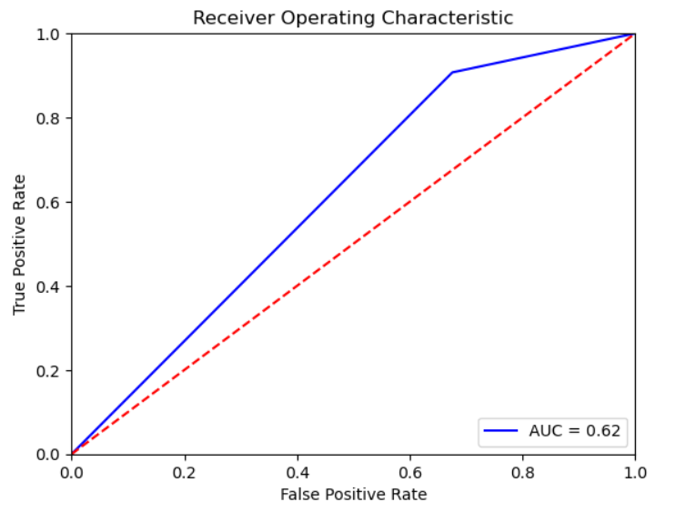
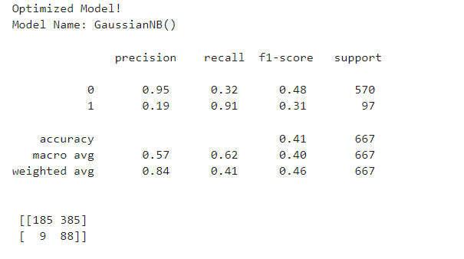
Naïve Bayes

Slide 10
Insights
LogisticRegression:
1.Precision: For class 1 (churned customers), the precision is 0.39, meaning that only 39% of the cases that are predicted to be churned are churned in reality. This suggests the model's churned customer predictions are not very accurate.
2.Recall: For class 1, the recall is 0.23, meaning that only 23% of real churned instances are correctly identified by the model. This suggests that the model is not capturing a significant portion of actual churned customers, leading to a low recall rate. The difference between precision and recall points to a possible problem where the model might be misclassifying a sizable portion of non-churned customers as churned (leading to low precision) and failing to identify a sizable portion of actual churned customers (leading to low recall).
3.Support:The number of instances for each class is indicated by the support values. Class 0 (non-churned customers) has significantly more support (570 instances) than class 1 (churned customers), which has only 97 instances. The model may be biased towards the majority class (non-churned customers) and find it difficult to predict the minority class (churned customers) as a result of this imbalance in the class distribution.

Slide 11
GNB
Precision:With a precision of 0.95 for class 0, 95% of the instances that were predicted to be non-churned turn out to be so. This shows how accurate the model's predictions are for non-churning customers.However, the precision for class 1 is only 0.19, indicating that out of all instances predicted as churned, only 19% are actually churned. This suggests the model's churned customer predictions are not very accurate.
Recall: Class 0 (non-churned customers) has a recall of 0.32, meaning that only 32% of real non-churned instances are correctly identified by the model. By comparison, class 1 (churned customers) has a recall of 0.91, meaning that 91% of real churned instances are correctly identified by the model. This suggests that the model performs much better in identifying churned customers compared to non-churned customers.
Support:Class 0 (non-churned customers) has significantly more support (570 instances) than class 1 (churned customers), which has only 97 instances. Again, same problem as logistic model GNB can be biased towards the majority class (non-churned customers) and find it difficult to predict the minority class (churned customers) as a result of this imbalance in the class distribution.

Slide 12


Ensemble Voting model Outputs
1. With respective accuracy scores of 0.76, the models with the highest scores are the Logistic Regression and VotingClassifier (Ensemble Model with Voting). With an accuracy score of 0.67, Gaussian Naive Bayes (GaussianNB) has the lowest score.
2. With the highest accuracy scores, VotingClassifier and Logistic Regression both perform comparably well and demonstrate their accuracy in predicting the target variable. However, In terms of accuracy, Gaussian Naive Bayes lags behind the other models, which may indicate that it is not as successful as the other models in identifying the underlying patterns in the data.

Slide 13
Selection of Model
It is advised that Mr. John Hughes use the logistic regression model becausethe accuracy score comparison which was achieved using Ensemble Voting model and which is the aim of thispresentation to provide Mr. John Hughes with the best model.
Reasoning:The Logistic Regression model achieved the highest accuracy score of 0.76, alsose it is a widely used and understandable algorithm, stakeholders will find it easier to understand and believe the predictions made by logistic regression.

Slide 14
Further Steps
Feature Engineering and Selection: To better capture patterns related to customer churn, conduct in-depth feature engineering to extract more meaningful information from the current variables or create new features. This might involve integrating specific expertise, generating interaction terms, or changing the current variables. To find the most appropriate features for churn prediction, apply feature selection techniques like L1 regularization, feature importance ranking, or recursive feature elimination. The model's performance may increase and its interpretability may increase with a decrease in features.
Model Tuning and Evaluation: Adjust the Logistic Regression model's hyperparameters with methods such as grid search or randomized search. The model can perform better in prediction and be able to better generalize to unknown data by fine-tuning hyperparameters like penalty type and regularization strength.

